Slide 1

L XURY HOTEL Aggregator
DATA
ANALYSIS

Slide 2
CONTENT OF THE PROJECT
“As the traveler who has once been from home is wiser than he who has never left his own doorstep,
so a knowledge of one other culture should sharpen our ability to scrutinize more steadily, to appreciate more lovingly, our own.” – Margaret Mead
OBJECTIVE | To understand the Business Objective/goal to achieve and with what tools.
RESOURCES AND TOOLS | What are the resources available, Microsoft Power BI will be primary tool for this project.
MILESTONES | Set the goals for each iteration Clear in timely manner to meet the project time-line.
APPROACH | Design the Requirement Document, Functional Requirement and Data Model to follow.
DATA SOURCES | Data Extraction/Retrieval from internal and External Data Sources like Cloud, Data Lake.
FINAL REPORT | Prepare the Presentation With All the data-driven insights and project Recommendations

Slide 3
TABLE OF CONTENTS
01
02
03
04
05
06
DATA COLLECTION
DATA CLEANING
PROBLEM STATEMENT
Dataset was retrieved from the Cloud(Google Drive)Section of Mentoreness, As a part of Internship Project.
Data cleaning inconsistencies, and missing values in the dataset to ensure its accuracy and reliability for analysis.
Develop the Business Requirement Document, Transforming data into actionable insights to optimize the hotel booking experience.
DATA ANALYSIS
VISUALIZATION & PRESENTATION
DATA
PREPARATION
Performing Data Analysis for key Performance Indicator(KPIs) to look for the solution to Business Problems
Present Data-driven insights and findings in terms of visuals and dashboard to stakeholders.
Data Preparation &transforming, and structuring the dataset to ensure its accuracy, suitability for analysis.

Slide 4

MISSION STATEMENT
The hospitality industry, especially hotel aggregators, thrives on understanding customer needs and market trends. This internship project focuses on analyzing a dataset of hotel aggregator listings using Power BI. The dataset is rich with various attributes related to listings, hosts, reviews, and availability.
The objective is to derive actionable insights to enhance the performance and competitiveness of these listings.
The project aims to conduct a comprehensive analysis of a hotel aggregator dataset, focusing on identifying trends, patterns, and factors influencing listing performance. Using Power BI, to create insightful visualizations to explore key metrics such as pricing, availability, host characteristics, and review scores.

Slide 5

OUR CLIENT
L XURY HOTEL
Luxury Hotels is a chain of luxurious retreat nestled in the various part of the world with different property Owners listed and Franchised under the Group name.
Problem Areas:
Understand the geographical concentration of listings and host locations with Property Popularity.
Pricing And Availability Analysis
Host Demographic, Performance and Correlation with Listings
Evaluate Review scores to understand the Effect on Property Listing with respect to revenue.
Popularity On Property Type and Room Types with respect to Reviews and Gross Revenue.

Slide 6
DATA CLEANING
Datatype
Correct
Data Transformation
CSV File Extraction
Clean Data, Ready for Processing
Data Format
Correction
Data Cleaning Involved Removing Duplicates, Missing/Null Values, Eliminate Extra Noises(Irrelevant Columns), Fixing Structural Errors like t and f to Yes and No for Verification and Super Host, check for outliers, Standardise and Normalize the Dataset before begin Analysis.
Notes:
Breakk

Slide 7

01
GEOGRAPHICAL INSIGHTS
L XURY HOTEL
Utilize geospatial visualization techniques to analyze the distribution of listings and host locations, identifying popular neighborhoods and areas of high listing concentration.

Slide 8
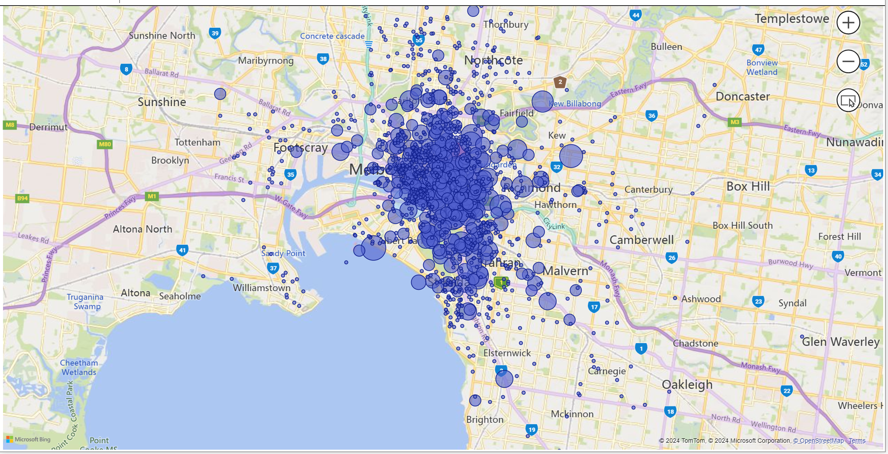
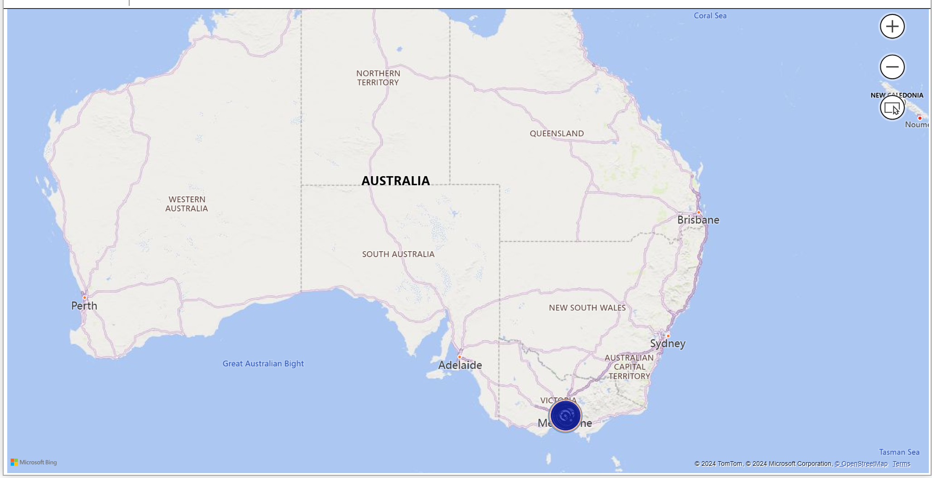
Geographical Representation of Guest Location
Australia has highest No. of Host Listings and Host Locations.

Slide 9

02
PRICING AND AVAILABILITY
L XURY HOTEL
Examine pricing trends across different property and room types, as well as accommodation capacity. Investigate listing availability over time to identify peak periods.
—SOMEONE FAMOUS

Slide 10
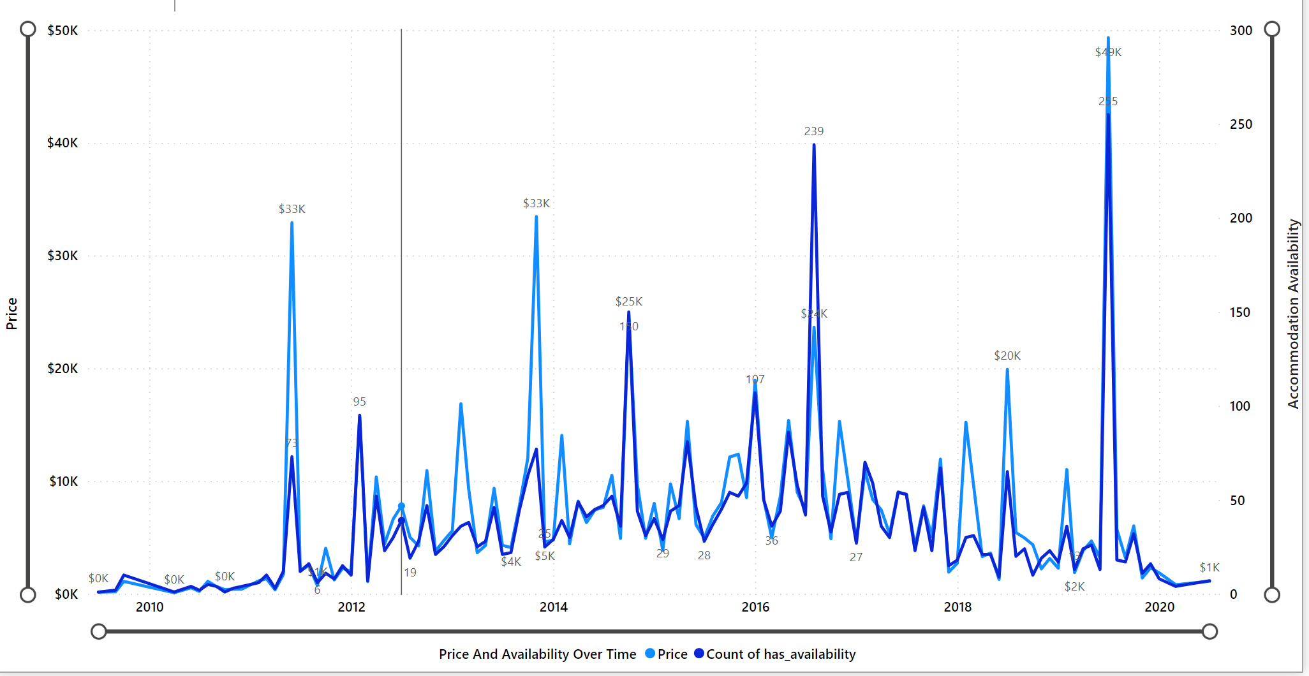
PRICING VS AVAILABILITY TRENDS
The Line chart represents the similar trend in August 2016 with higher slight lower in availability.
November 2013 and June 2011 had reported the similarity and pattern in Revenue with No. of Accommodation Availability
The Highest availability was total 255 with Gross Revenue $49.3K in July 2019
JULY 2019

Slide 11
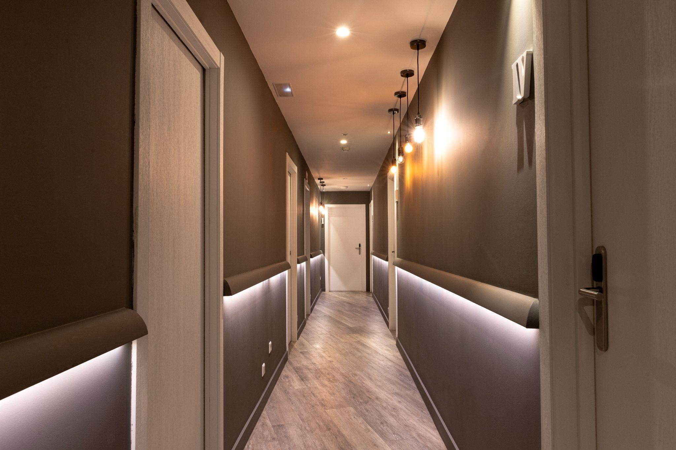
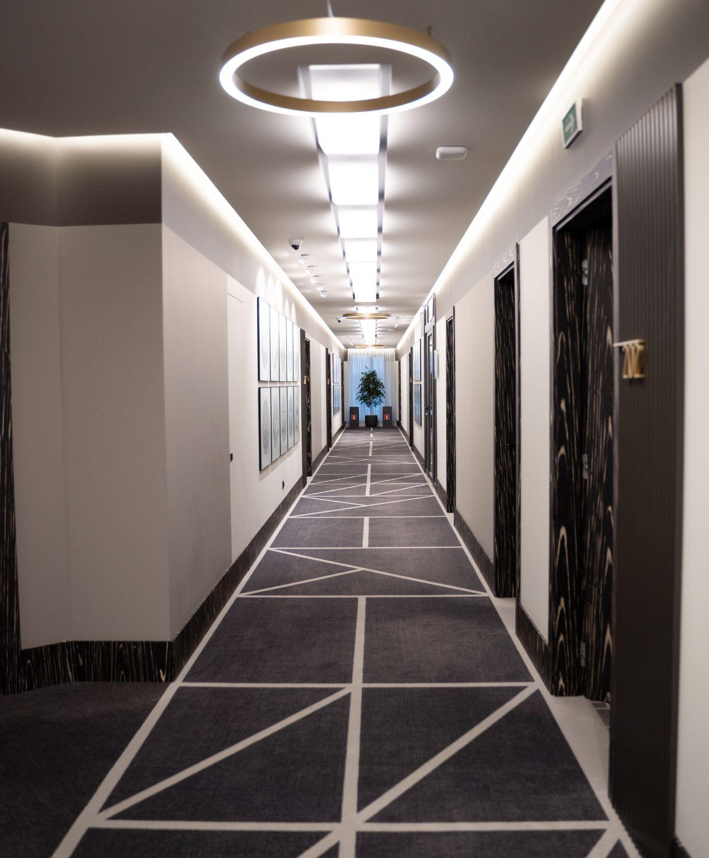
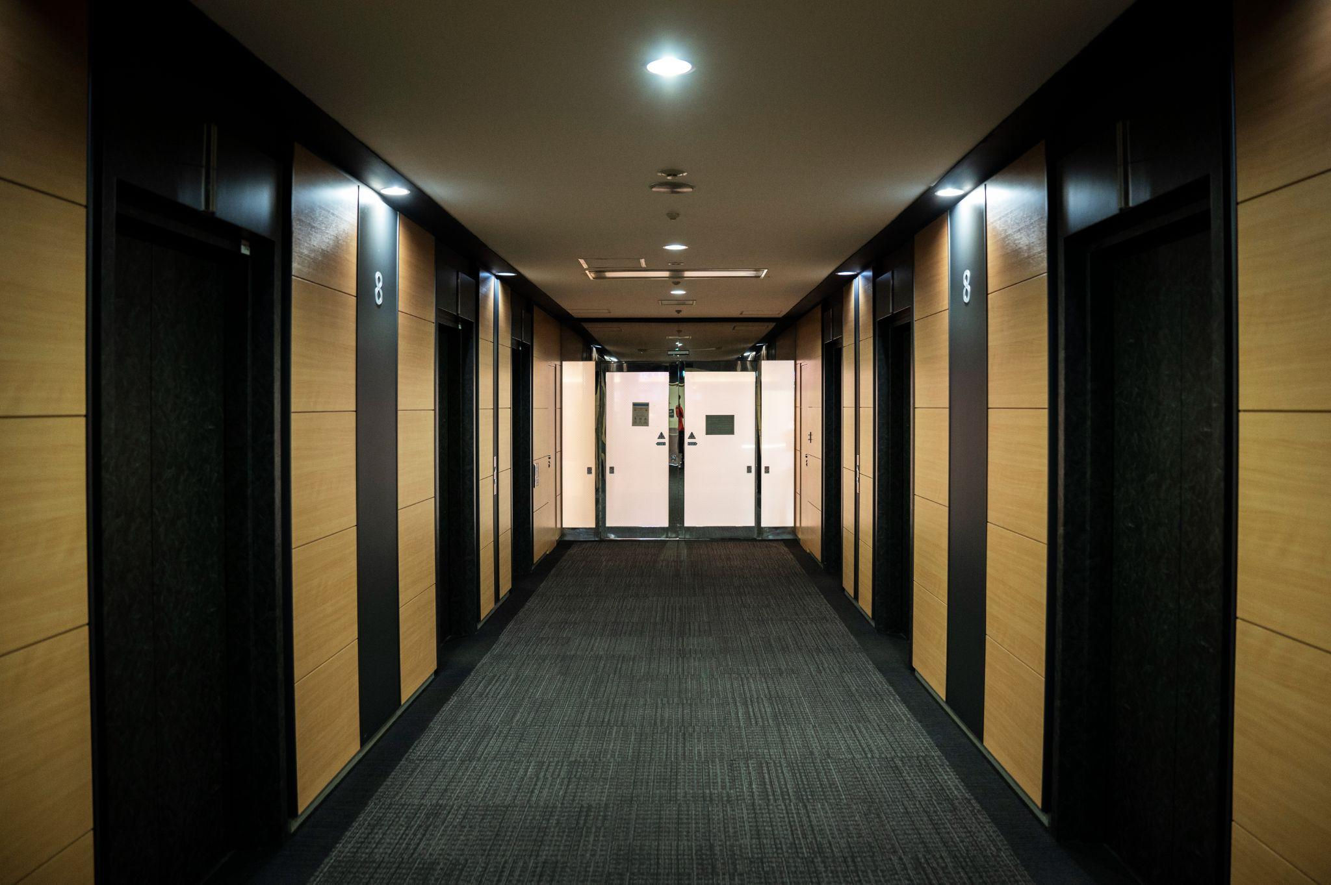
DATA FILTERS
PROPERTY TYPE
ROOM TYPE
OCCUPANCY

Slide 12


03
HOST PERFORMANCE
L XURY HOTEL
Assess host performance by analyzing characteristics such as super host status, response times, and verification methods. Explore correlations between host attributes and listing performance to understand their impact on overall performance.

Slide 13

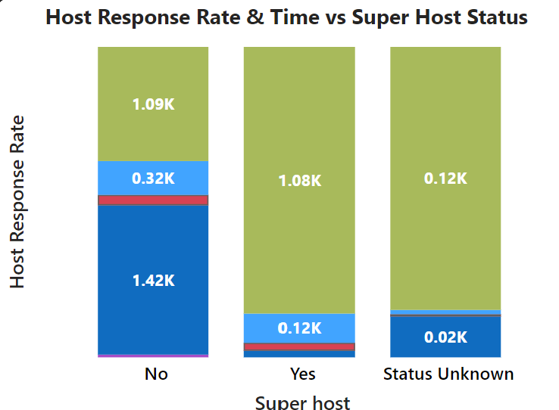
PROBLEM
Evaluate host characteristics, including super host status, response times, and verification methods. - Explore correlations between host attributes and listing performance.
CORRELATION BETWEEN SUPER HOST STATUS AND
HOST RESPONSE RATE & TIME
The Column Chart shows about 4.1K host are super host and Verified, 243 hosts are not super host, but Not verified.
Data represents more than half host listings has response rate 100% and Average response time was “with in an hour”.

Slide 14

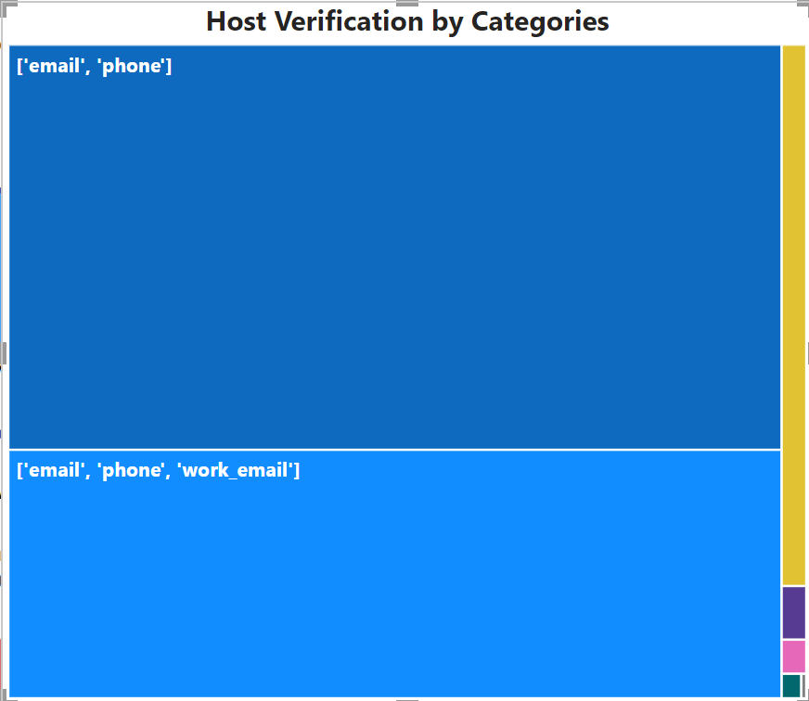
HOST VERIFICATION
The Tree map shows over 80% which is 4.3K of Hosts has choose to verify with their Email and Contact Numbers. Less than 1% hosts has used either phone or work email for verification purpose.

Slide 15

04
REVIEW SCORE AND GUEST SATISFACTION
L XURY HOTEL
Analyze review scores to gauge their impact on listing performance and overall guest satisfaction. Identify areas for improvement by examining specific review categories.

Slide 16
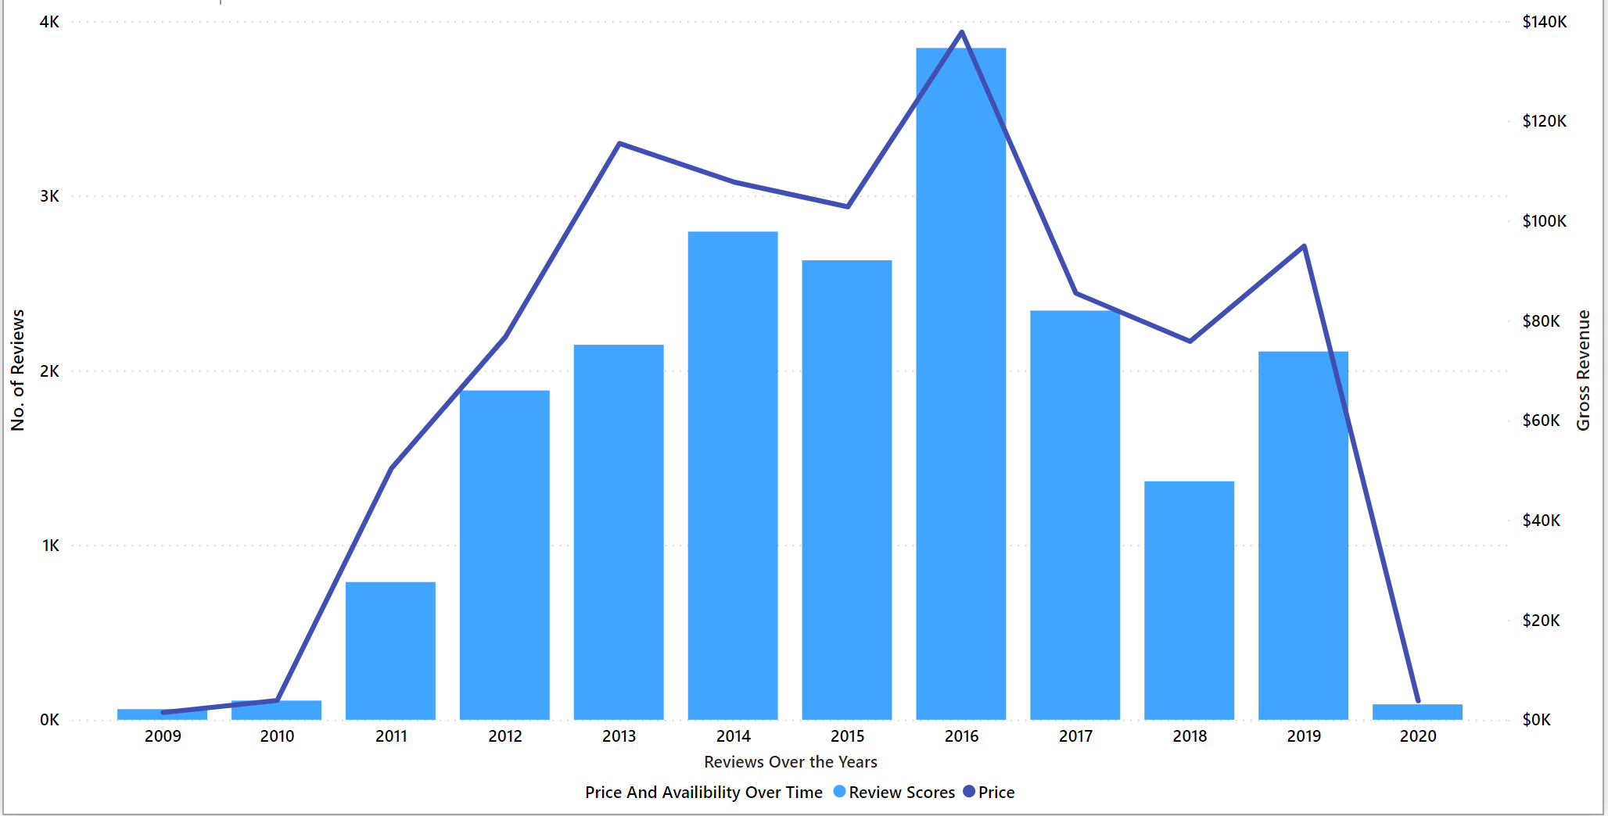
GUEST REVIEW AND ITS EFFECT ON LISTING
The graph represents a positive correlation between host Reviews and its impact on the gross revenue and Listing performance. The trend line represents the year 2016 was the highest with reviews, listings and Revenue

Slide 17
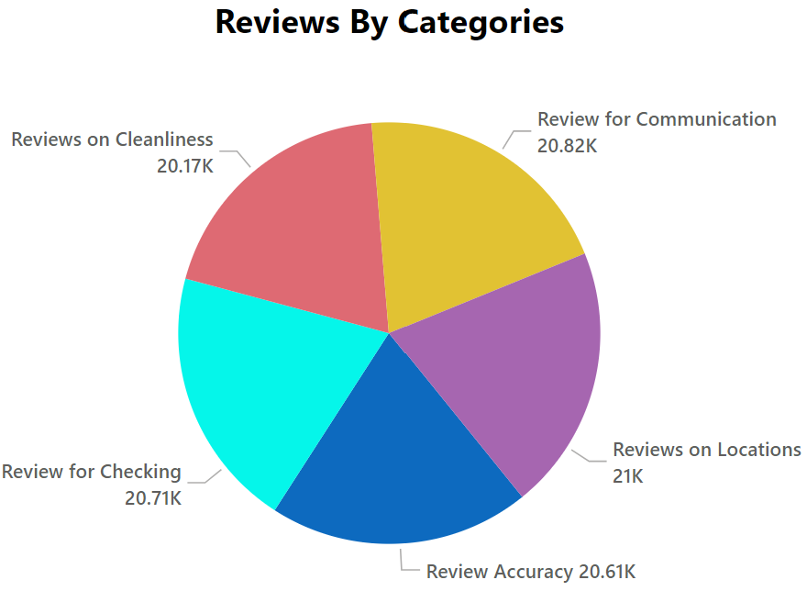
REVIEWS BY CATEGORIES
20.17K
Reviews on Cleanliness
20.61K
Reviews on Accuracy
20.82K
Reviews on Communication
20.71K
Reviews on Checking Process
21K
Reviews on Locations
The distribution of Reviews by Categories shows each category contributes about 20% to the total Reviews posted which reflects customers satisfaction with services.

Slide 18




PROPERTY TYPE AND ROOM ANALYSIS
05
Analyze the distribution of property types and room types, exploring trends in the popularity of specific accommodation setups.
L XURY HOTEL

Slide 19
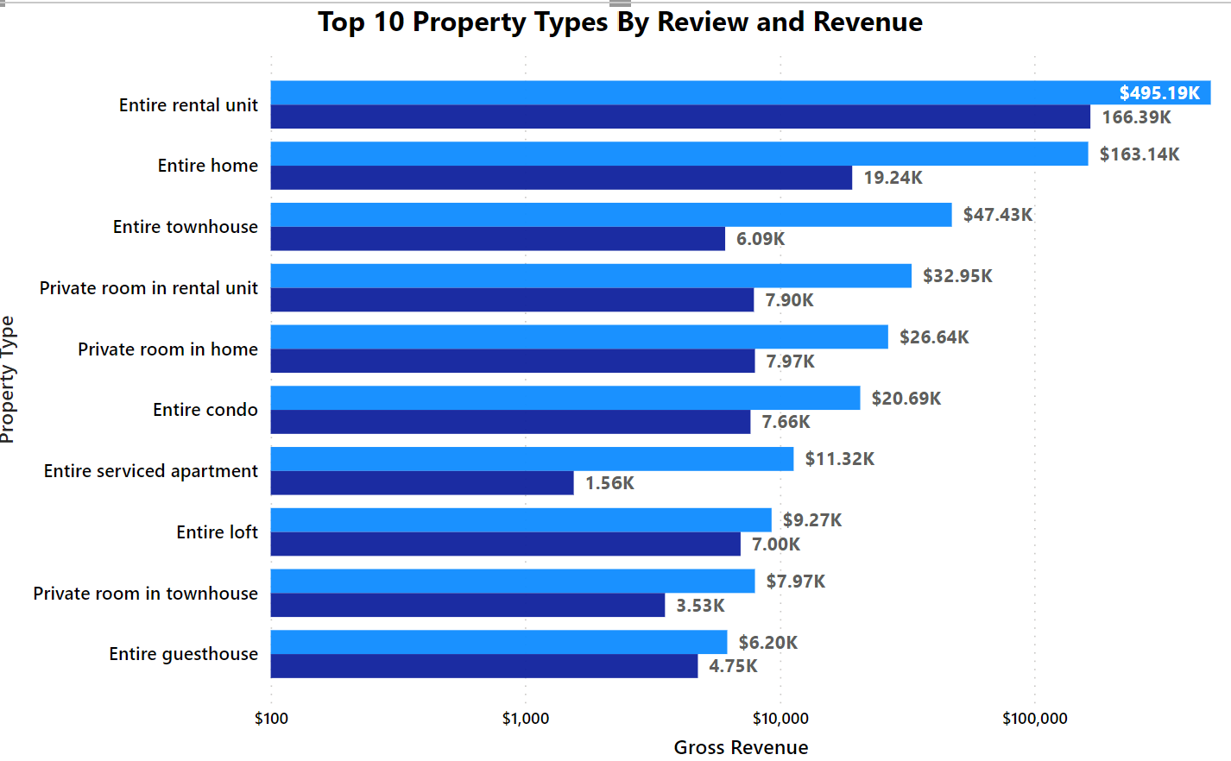
POPULAR PROPERTY TYPE WITH TOTAL REVIEWS

Slide 20
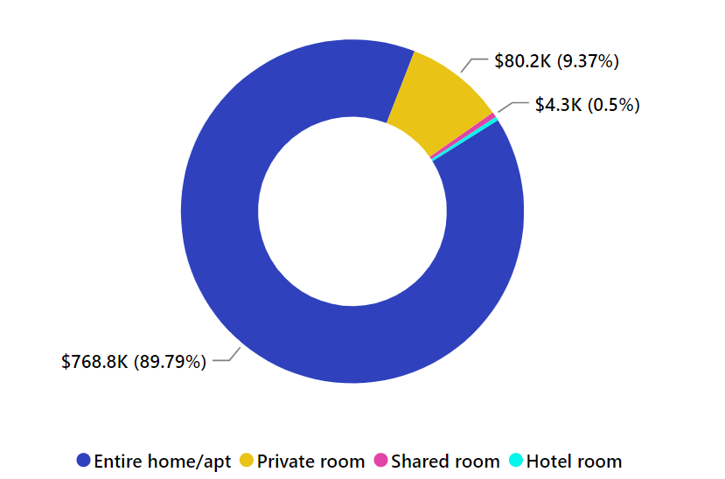
ROOM TYPE ANALYSIS
The most popular room type is Entire Home/Apartment, which can accommodate more than 5-6 pax, however according to the donut chart, on the opposite, guests prefer private room with single or max 2 occupancy.
Less then 1% people mark their choice on shared rooms or hotel rooms.

Slide 21
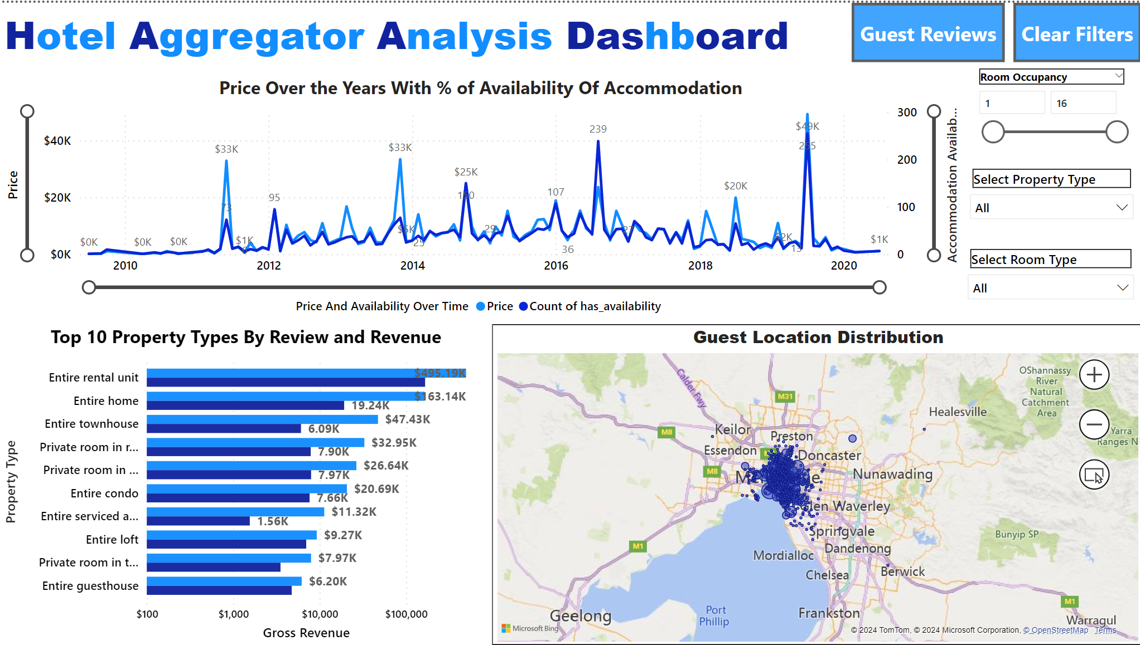
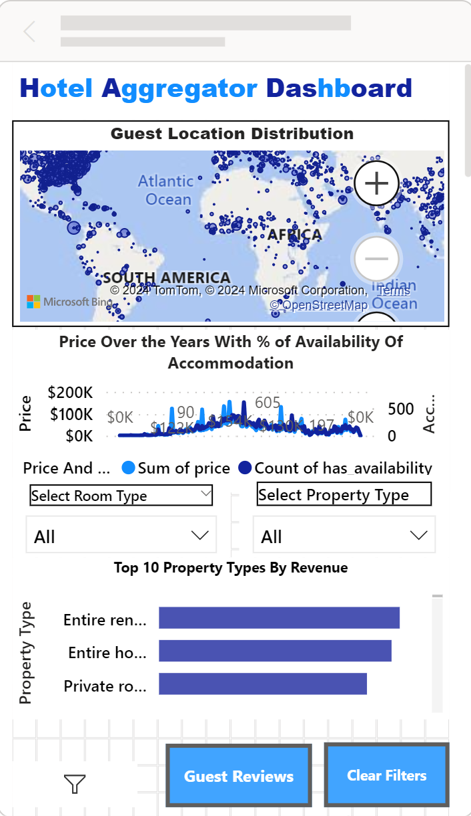
MOCKUP DEVICE
L XURY HOTEL

Slide 22

INSIGHTS
L XURY HOTEL
Map represents Australia has highest no. of Listings and Host Locations checked-ins registered.
The line chart shows July 2019 has highest grossing revenue reported with 255 accommodation availability. Similar pattern was shown in August 2016, November 2013 and June 2011.
The Column Chart shows about 4.1K host are super host and Verified, 243 hosts are not super host, but Not verified.
Data represents more than half host listings has response rate 100% and Average response time was “with in an hour”.
The Tree map shows over 80% which is 4.3K of Hosts has choose to verify with their Email and Contact Numbers. Less than 1% hosts has used either phone or work email for verification purpose.
Data represents a positive correlation between host Reviews and its impact on the gross revenue and Listing performance. The trend line represents the year 2016 was the highest with reviews so as listings and Revenue
According to the dataset, Most guests prefer entire home or apartment as the most popular rental choice which contributed 89.8% to gross revenue.

Slide 23

OUR PLANS
GET THE HOSTS VERIFIED
RECOMMEND DIGITAL SURVEY AS A PART OF PROMOTION
Host verification builds trust hence, to improve the sale and review performance get maximum hosts verified.
Provide Badges or stars as a part of action to boost the confidence.
Encourage guests to provide digital survey to review the property, host behaviour, areas to improve and what would they like to add as extra amenities to improvise their stay.

Slide 24

OUR TEAM
Mentorness
Dipal Paneri
Mentorness is a proof-of-work-based hiring platform. Skilled candidates often struggle to connect with jobs that match their skills, and while companies, due to high competitive market, have hard time discovering the right fit for their requirements, here to serve as the connecting bridge between these two worlds.
Lead Data Analyst on the Project for Client Luxury Hotels For Hotel Aggregator Analysis, Has background in IT and Data. Passionate about Data Analytics and believes in Quality of work and Constant learning from each mistake.

Slide 25

4362 Listed Locations
$856.209K Revenue
76 Host Listings
250064 Reviews
322 Unique Locations

Slide 26

THANKS!
DIPAL PANERI
Do you have any questions?
Email at Paneri.dipal@yahoo.com
This Project was a part of Mentoreness Internship Program.
Website : https://www.mentorness.com/
LinkedIn : https://www.linkedin.com/company/mentorness/?originalSubdomain=in

